Slide 1

Any suitable information
Institute / University logo
A Presentation on
Paper Title: Change the Color and Size as per your need (Use only Arial or Calibri font for all slides)(Line spacing 1.15 to 2)
authored by
Author 1, Department, Institute, University, City, State, Country (Presenting Author - Bold)
Author 2, Department, Institute, University, City, State, Country
Author 3, Department, Institute, University, City, State, Country
Author 4, Department, Institute, University, City, State, Country
Paper ID: 11111
at
The International Conference on Multidisciplinary Engineering and Scientific Research 2026 (ICMESR 2026)
organized by Pravara Rural Engineering College, Loni, Ahilyanagar, Maharashtra, India (affiliated with Savitribai Phule Pune University, Pune), in association with the Government Polytechnic, Afzalpur, Dist. Kalburgi, Karnataka, India and Technology Research and Innovation Centre, Pune, India.
18-19 May 2026

Slide 2
Content
Institute / University logo
A sample. Content, Bullets and numbering style can be used as per need. Font size at least 18
Introduction & Background
Problem Statement / Objectives of the Study
Literature Review (Brief Overview) with Research gap
Methodology / Experimental Setup (As applicable)
Proposed Model / System Design (As applicable)
Results and Analysis
Discussion of Findings
Applications & Practical Implications
Conclusion
Future Scope of Work
References
Any one form - Paper Title / Institute / University / Authors

Slide 3
Important Instructions_01
Institute / University logo
Following are important instruction to presenters.
There is no limit for number of slides.
However, presenter need to complete the presentation within 10 minutes.
2 minutes for Q & A.
Any one form - Paper Title / Institute / University / Authors

Slide 4
Important Instructions_02
Institute / University logo
Following are important instruction to presenters.
All figures and tables should be clear. They must be named.
Figure title should be below figure
Table title should be above table.
All fonts should be readable where required in Figures and Tables
Bullets can be selected appropriately.
Any videos can be also added if required
Avoid crowded slides and long sentence reading. Avoid crowded slides and long sentence reading. Avoid crowded slides and long sentence reading. Avoid crowded slides and long sentence reading. Avoid crowded slides and long sentence reading.
Any one form - Paper Title / Institute / University / Authors

Slide 5
Important Instructions_02
Institute / University logo
Following are important instruction to presenters.
All figures and tables should be clear. They must be named.
Figure title should be below figure
Table title should be above table.
All fonts should be readable where required in Figures and Tables
Bullets can be selected appropriately.
Any videos can be also added if required
Any one form - Paper Title / Institute / University / Authors

Slide 6
Important Instructions_03
Institute / University logo
Following are important instruction to presenters.
Change the Color and Size as per your need
Use only Arial or Calibri font for all slides
Line spacing should be between 1.15 to 2
Any one form - Paper Title / Institute / University / Authors

Slide 7
Important Instructions_04
Institute / University logo
Following are important instruction to presenters.
These are general guidelines. However, the content will be changed based on the topic.
It is desirable to prepare content so that it can be easily understand by audience and experts.
Any one form - Paper Title / Institute / University / Authors

Slide 8
Important Instructions_05
Institute / University logo
Following are important instruction to presenters.
Avoid crowded slides and long sentence reading. Avoid crowded slides and long sentence reading. Avoid crowded slides and long sentence reading. Avoid crowded slides and long sentence reading. Avoid crowded slides and long sentence reading. Avoid crowded slides and long sentence reading. Avoid crowded slides and long sentence reading.
Any one form - Paper Title / Institute / University / Authors

Slide 9
Important Instructions_05
Institute / University logo
Following are important instruction to presenters.
Avoid such
      too big fonts or
      too small fonts
Any one form - Paper Title / Institute / University / Authors

Slide 10
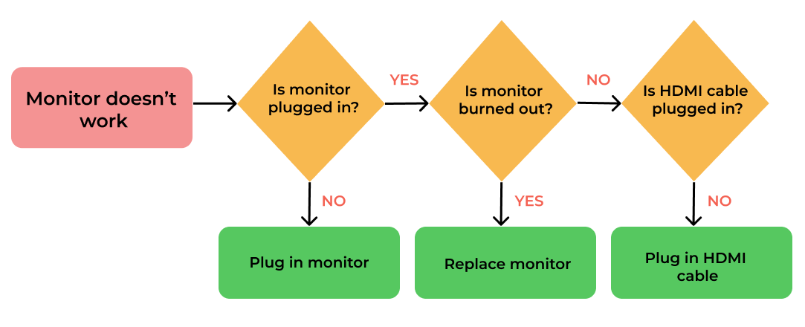
Sample Figure
Institute / University logo
Following are important instruction to presenters.
Use clear and readable figure
Sample Figure showing clarity and position
Any one form - Paper Title / Institute / University / Authors

Slide 11
Sample Table
Institute / University logo
Following are important instruction to presenters.
Use clear and readable table content
Parameter | One | Two | Three | Four
Length | 256 | 245 | 654 | 456
Width | 55 | 86 | 79 | 31
Height | 789 | 123 | 369 | 713
Sample Table showing clarity
Any one form - Paper Title / Institute / University / Authors

Slide 12
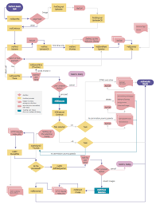
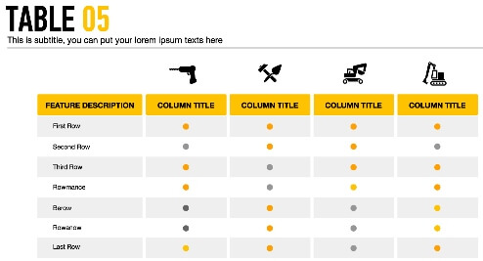
Don’t use such Unclear Tables or Figures
Institute / University logo
Following are important instruction to presenters.
Don’t use
Any one form - Paper Title / Institute / University / Authors

